Slide 1
MICROSOFT POWER bi

Slide 3
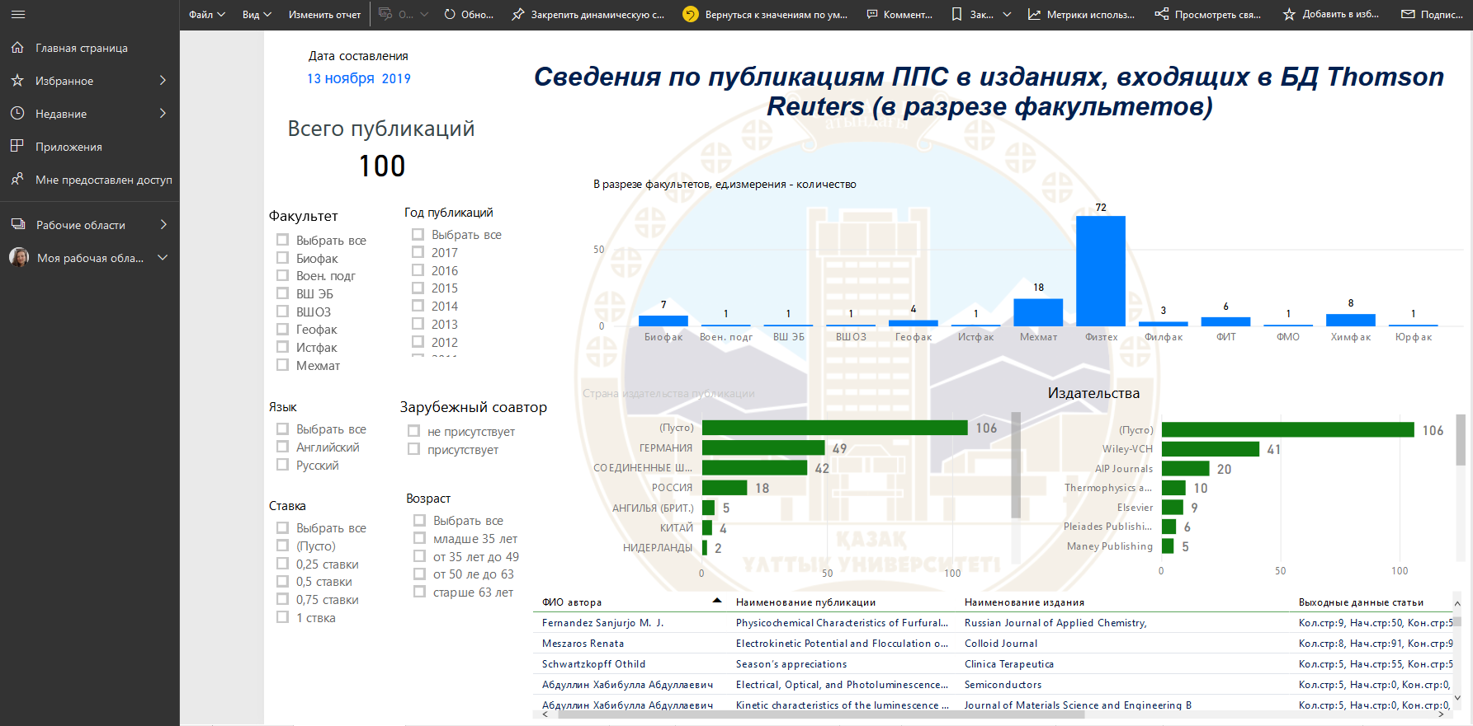
POWER BI Dashboards

Slide 4
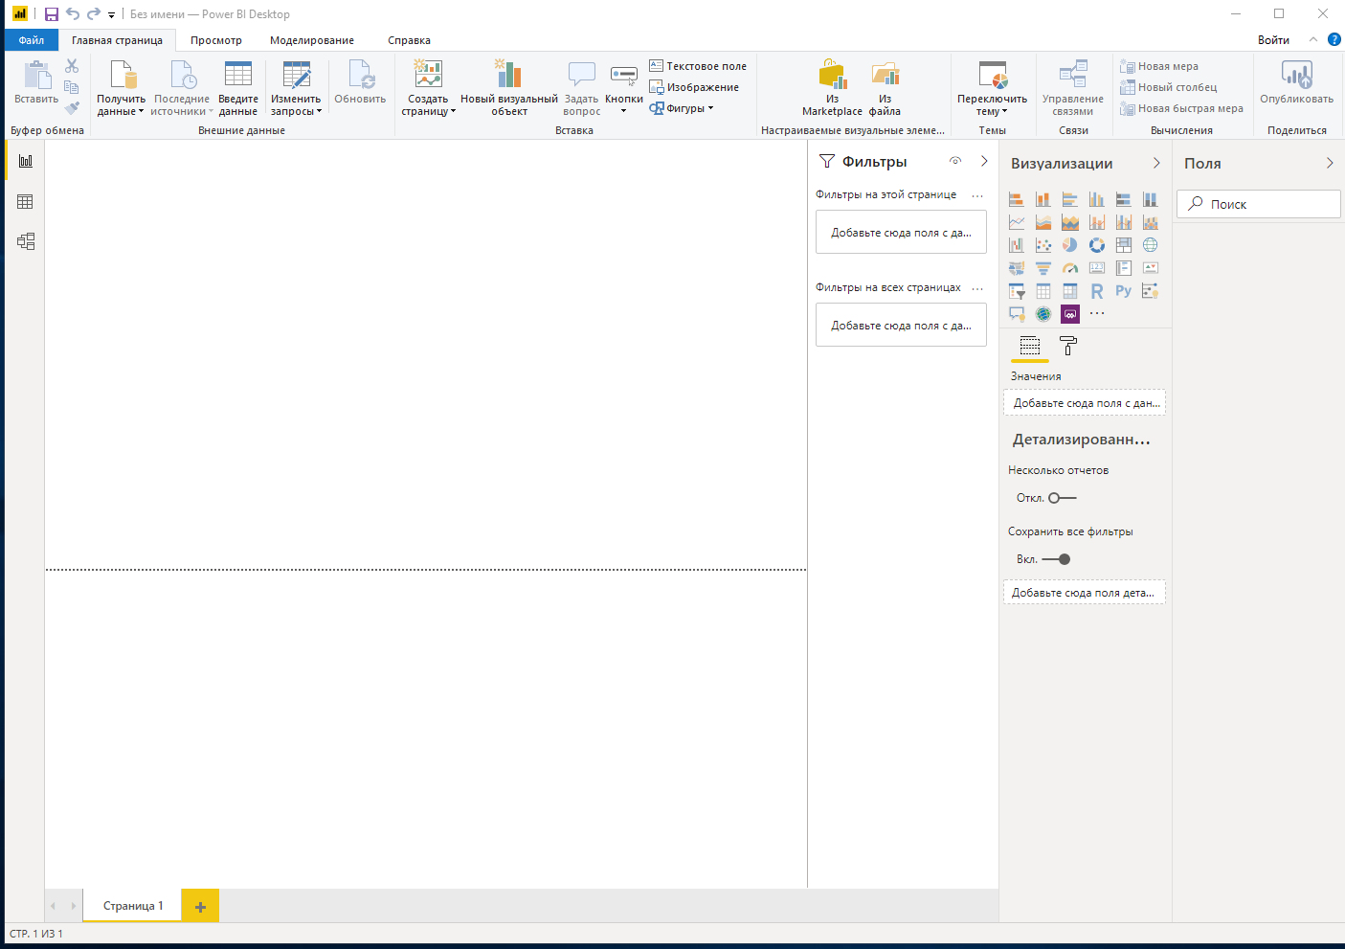
Power bi features
Loading data from the source

Slide 5
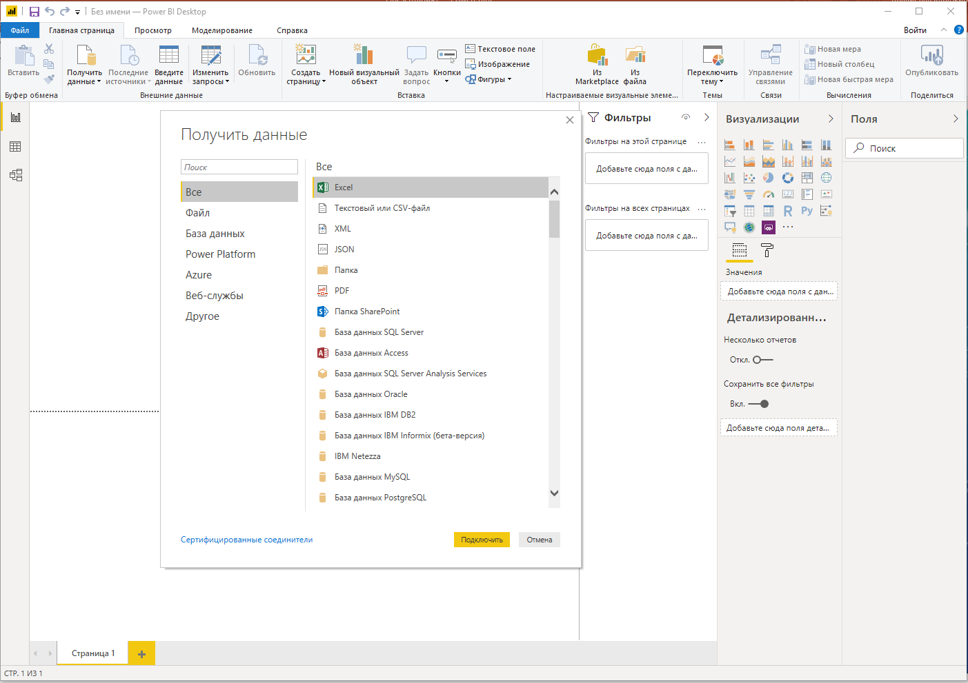
Power bi work area
You will come across a dialog box with variety of options with different file types to load. Select the file type of your choice and proceed with “Connect”

Slide 6
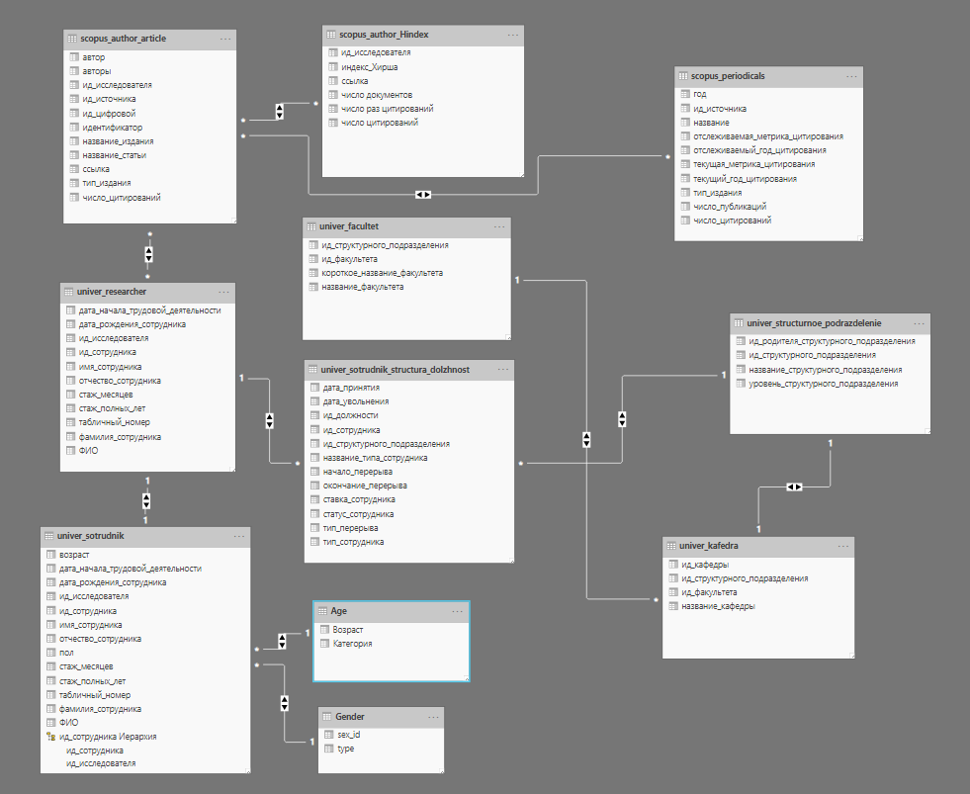
Power bi relations

Slide 7
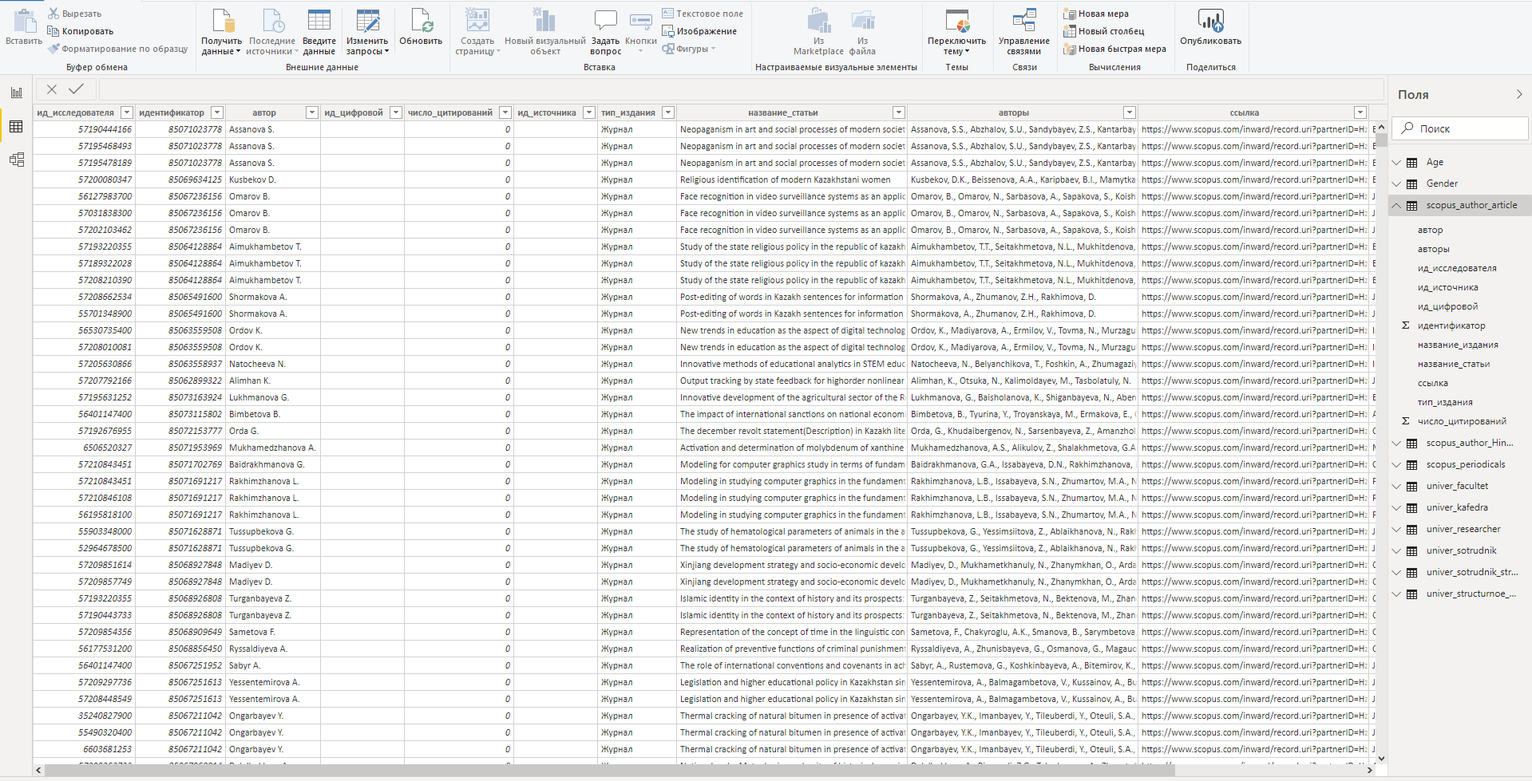
Power bi data

Slide 8
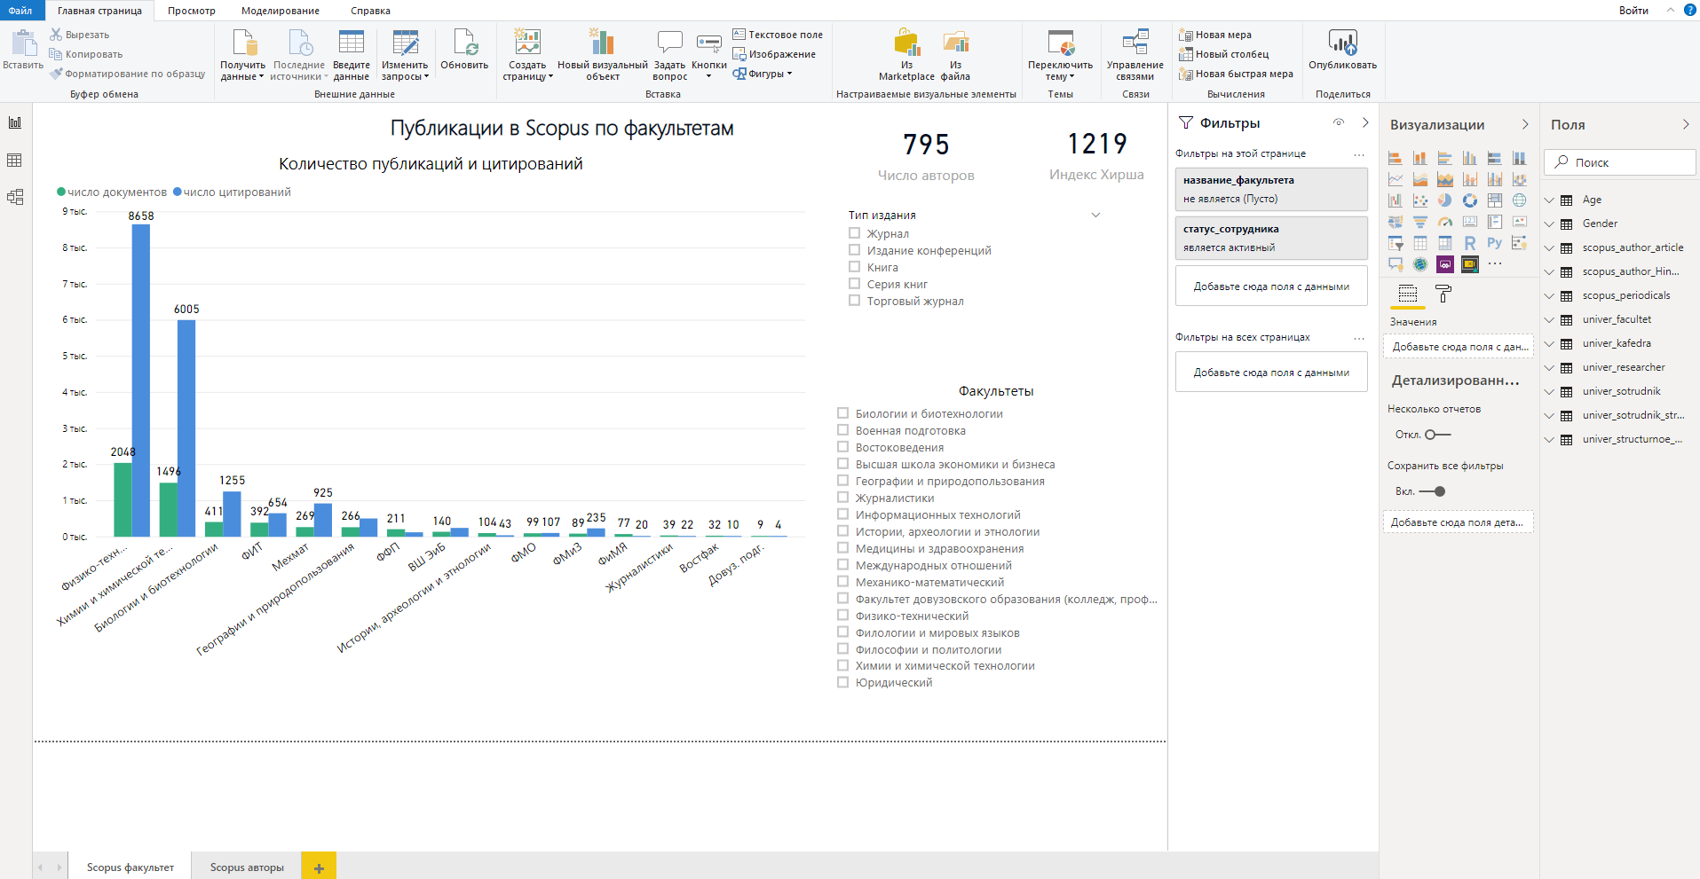
Power bi visualization

Slide 9
Power bi features

Slide 10
Power bi features
Drag fields from the “Fields” area onto the existing field area. If you drop them somewhere else on the canvas, they would plot individually as a unit parameter and will not contribute to the group plotting.

Slide 11
Power bi features

Slide 12
Power bi features

Slide 13
Power bi features

